Slide 1

Verification in Event-B
Michael Butler

Slide 2
Validation and verification
Requirements validation:
The extent to which (informal) requirements satisfy the needs of the stakeholders
Model validation:
The extent to which (formal) model accurately captures the (informal) requirements
Model verification:
The extent to which a model correctly maintains invariants or refines another (more abstract) model
Measured, e.g., by degree of validity of proof obligations

Slide 3
Event structure
E = \\ event name
any
x1, x2, … \\ event parameters
where
G1 \\ event guards (predicates)
G2
…
then
v1 := exp1 \\ event actions
v2 := exp2
…
end

Slide 4
Role of Event Parameters
Most generally, parameters represent nondeterministically chosen values, e.g.,
NonDetInc =
any d where v+d ≤ MAX then v:=v+d end
Event parameters can also be used to model input and output values of an event
Can also have nondeterministic actions:
when v<MAX then v :| v < v’ ≤ MAX end

Slide 5
Refinement for events
A refined machine has two kinds of events:
Refined events that refine some event of the abstract machine
New events that refine skip
Verification of event refinement uses
gluing invariants linking abstract and concrete variables
witnesses for abstract parameters

Slide 6
Proof obligations in Event-B
Well-definedness (WD)
e.g, avoid division by zero, partial function application
Invariant preservation (INV) ***
each event maintains invariants
Guard strengthening (GRD) ***
Refined event only possible when abstract event possible
Simulation (SIM) ***
update of abstract variable correctly simulated by update of concrete variable
Convergence (VAR)
Ensure convergence of new events using a variant

Slide 7
Invariant Preservation
Assume: variables v and invariant I(v)
Deterministic event:
Ev = when P(v) then v := exp(v) end
To prove Ev preserves I(v):
INV: P(v), I(v) ⊢ I( exp(v) )
This is a sequent of the form Hypotheses ⊢ Goal
The sequent is a Proof Obligation (PO) that must be verified

Slide 8
Using Event Parameters
Event has form:
Ev = any x where P(x,v) then v := exp(x,v) end
INV: I(v), P(x,v) ⊢ I( exp(x,v) )

Slide 9
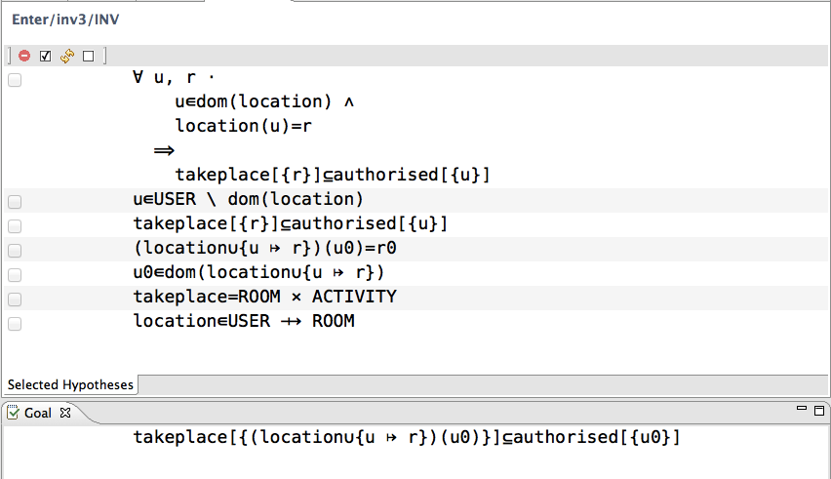
Example PO from Rodin

Slide 10
Simulation: maintaining a gluing relation
a0
abs
a1
a0
J
J
c0
con
c1

Slide 11
New concrete events refine skip (stuttering step)
a
J
J
c0
new
c1

Slide 12
Refining traces
abs1
abs2
abs3
J
J
J
J
J
con1
new1
con2
new2
con3

Slide 13
Proof method for refinement (deterministic case)
Suppose event con refines event abs:
abs = when P(a) then a := E(a) end
con = when Q(c) then c := F(c) end
Verification of this refinement gives rise to two Proof Obligations:
GRD: I(a), J(a,c), Q(c) ⊢ P(a)
SIM: I(a), J(a,c), Q(c) ⊢ J( E(a), F(c) )
See [Abrial 2010] for non-deterministic case of refinement POs using witnesses

Slide 14
Event traces of a system M
Event labels Ev
States S Initial states I
Transition relation R ∈ Ev → (S ↔ S)
Lift R to sequences:
R( ⟨ ⟩ ) = ID
R( ⟨e⟩ t ) = R(e) ; R(t)
t is a trace of M iff R(t)[ I ] ≠ ∅

Slide 15
Event traces with new (hidden) events
Transition relations
R ∈ Ev → (S ↔ S)
H ∈ S ↔ S
Lift R:
R( ⟨ ⟩ ) = H*
R( ⟨e⟩ t ) = H* ; R(e) ; H* ; R(t)
t is a trace of M iff R(t)[ I ] ≠ ∅

Slide 16
Refinement
MA refined by MC
Semantically: traces(MC) ⊆ traces(MA)
Proof rule using gluing invariant J:
Each MA.e is (data) refined by MC.e under J
Each MC.h refines skip under J
These are sufficient conditions for trace refinement
Prove by induction over traces that
t is a trace of MC ⇒ t is a trace of MA

Slide 17
Proving data refinement of events
An event on variable a can be characterised as a before-after predicate RA(a,a’), e.g,
a<10 ∧ a’=a+1
RA is data refined by PC under gluing invariant J:
RC(c,c’), J(a,c) ⊢ ∃a’ • RA(a,a’) ∧ J(a’,c’)
In relational terms, we write this as
J ; RC ⊆ RA ; J

Slide 18
Data refinement of event traces
Assume data refinement for all observable events e and hidden events h:
J ; RC(e) ⊆ RA(e) ; J
J ; RC(h) ⊆ J
Proof by induction
J ; RC(H)* ⊆ J
Proof by induction for observable event trace t:
J ; RC(t) ⊆ RA(t) ; J
Initialisation
c∈IC ⇒ ∃a• a∈IA ∧ J(a,c)

Slide 19
Proof for event trace refinement
t is a trace of MC
= RC(t)[ IC ] ≠ ∅ // definition
= ∃c,c’ • c∈IC ∧ RC(t)(c,c’) // rewrite
⇒ ∃c,c’,a • c∈IC ∧ a∈IA ∧ J(a,c) ∧ RC(t)(c,c’)
// initialisation refinement
= ∃c’,a • a∈IA ∧ (J ; RC(t))(a,c’) // defn of ;
⇒ ∃c’,a • a∈IA ∧ (RA(t) ; J)(a,c’) // inductive theorem
⇒ ∃a,a’ • a∈IA ∧ RA(t) (a,a’) // defn of ;
= RA(t)[ IA ] ≠ ∅ // rewrite
= t is a trace of MA // definition

Slide 20
Expanding the data refinement condition in Event-B
Events of the form
A = when GA(a) then a :| SA(a,a’) end
C = when GC(c) then c :| SC(c,c’) end
Gluing invariant is of the form
I(a) ∧ J(a,c)
I is the invariant of MA, J is the invariant of MC
Data refinement PO:
GC(c) ∧ SC(c,c’), I(a), J(a,c)
⊢ ∃a’ • GA(a) ∧ SA(a,a’) ∧ I(a’) ∧ J(a’,c’)

Slide 21
Witness predicate
Existential quantification allows for relational data abstraction (non-determinism)
BUT the existential quantification makes it difficult to decompose the data refinement PO
The witness predicate for an event captures the nondeterminism in the data refinement for that event
Used to decompose the data refinement PO

Slide 22
Event-B Refinement POs
WFIS:
GC(c) ∧ SC(c,c’), I(a), J(a,c) ⊢ ∃a’ • W(a’,c,c’)
GRD:
GC(c) ∧ SC(c,c’), I(a), J(a,c) ⊢ GA(a)
SIM:
GC(c) ∧ SC(c,c’), I(a), J(a,c), W(a’,c,c’) ⊢ SA(a,a’)
INV (abstract):
GC(c) ∧ SC(c,c’), I(a), J(a,c), W(a’,c,c’) ⊢ I(a’)
INV (concrete):
GC(c) ∧ SC(c,c’), I(a), J(a,c), W(a’,c,c’) ⊢ J(a’,c’)

Slide 23
Event-B and data refinement
The combination of the Event-B POs entail the data refinement condition:
GC(c) ∧ SC(c,c’), I(a), J(a,c)
⊢ ∃a’ • GA(a) ∧ SA(a,a’) ∧ I(a’) ∧ J(a’,c’)
Note that the abstract invariant PO is already part of the abstract model verification so does not get regenerated for the refined machine

Slide 24
Witnesses in practice
Commonly non-determinism is in the choice of parameter value:
Event ≙
any x, y where G then v := E(v) end
In a refinement, the parameter can be replaced by something more concrete (or removed). Witness parameter is used for linking:
Event’ ≙ refines Event
any x’, y where G’
with x = F(w,x’,y) // deterministic witness
then w := E’(w) end // means ∃is eliminated

Slide 25
Example: removing a parameter
Abstraction – set of used values:
ChooseFresh ≙
any x where x ∉ used
then used := used ∪ {x} end
Refinement – replace used by a counter:
@inv used = 0..cnt-1
ChooseFresh ≙
refines ChooseFresh
with x = cnt
then cnt := cnt + 1 end

Slide 26
Deadlock Freedom (Enabledness)
General Enabledness Preservation
grd(A1) ∨ … ∨grd(An)
⇒ grd(C1) ∨ … ∨grd(Cn)
If Machine A can make progress,
then so can Machine C
Strong Enabledness Preservation
grd(Ai) ⇒ grd(Ci)
If Ai is enabled, then so is the corresponding Ci

Slide 27
Deadlock Freedom (Enabledness)
Strong Enabledness Preservation with new events:
grd(Ai) ⇒ grd(Ci) v grd(N1) v … v grd(Nm)
If Ai is enabled then
either the corresponding Ci is enabled
or some new event Nj is enabled

Slide 28
Some references
Comprehensive definition of proof obligations (plus much more):
Jean-Raymond Abrial. Modeling in Event-B: System and Software Engineering. Cambridge University Press 2010
Event- B is strongly influenced by Back’s action system formalism:
State trace refinement:
Ralph-Johan Back and Joakim von Wright. Trace Refinement of Action Systems. CONCUR '94 http://tucs.fi/publications/view/?pub_id=pBW94
Event trace refinement:
Michael Butler. Stepwise Refinement of Communicating Systems
Science of Computer Programming, 27 (2), 1996
http://eprints.soton.ac.uk/250575/

